Slide 1
HEART DISEASE DIAGNOSTICS ANALYSIS
MOHAMMAD SOYAL

Slide 2
INTRODUCTION
Heart disease diagnostics are key for finding and managing heart problems early, which helps prevent serious issues.
Common methods include checking symptoms, using ECGs to measure heart activity, performing echocardiograms to look at heart structure, and stress tests to see how the heart handles exercise.
Tests like coronary angiography and blood tests provide more information.
Newer tools, such as genetic tests, wearable devices, and AI, make diagnosis more accurate and effective.
Detecting heart disease early allows for timely treatment, reducing risks and improving overall health and quality of life.

Slide 3
DATA COLLECTION
We have collected the data of heart disease
We have extracted the data from the below website
https://www.kaggle.com/datasets/alexteboul/heart-disease-health-indicators-dataset

Slide 4
DATA UNDERSTANDING
Data understanding process includes collectin g and exploring the data
The data we have collected consist of 1000 observations with 22 attributes
The attributes are :
age
sex
chest pain type (4 values)
resting blood pressure
serum cholestoral in mg/dl
fasting blood sugar > 120 mg/dl

Slide 5
DATA UNDERSTANDING
resting electrocardiographic results (values 0,1,2)
maximum heart rate achieved
exercise induced angina
oldpeak = ST depression induced by exercise relative to rest
the slope of the peak exercise ST segment
number of major vessels (0-3) colored by flourosopy
thal: 0 = normal; 1 = fixed defect; 2 = reversable defect

Slide 6
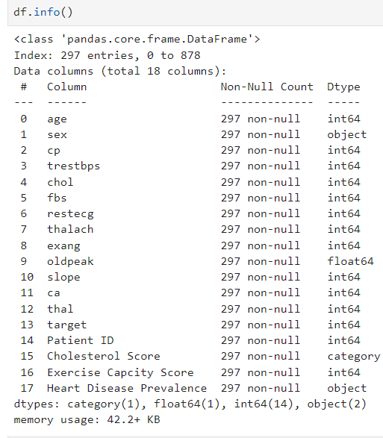
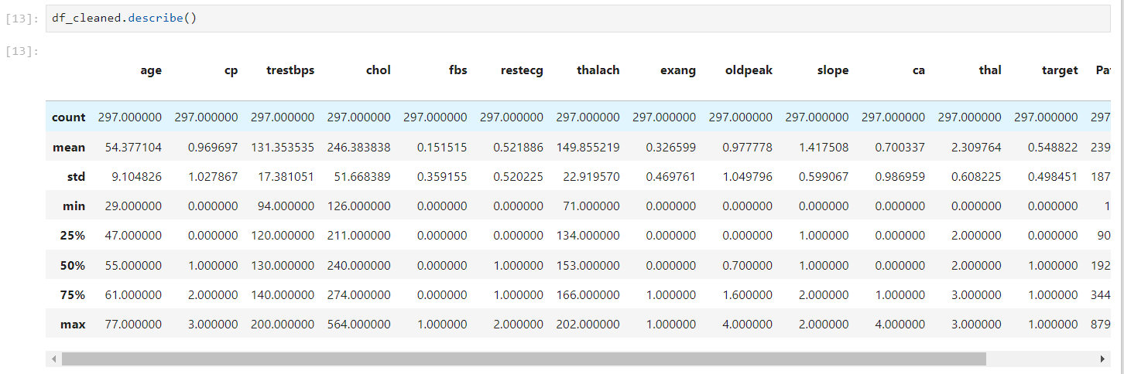
DATASET OVERVIEW
Based on the summary above, it appears that the data consists of a total of 920 observations. Howevevr, many features in this dataset have missing values, including testbps,chol,fbs,restecg,thalch,exang,oldpeak,slope,ca,and thal. In addition the datset contains both numeric and categorial variables.

Slide 7
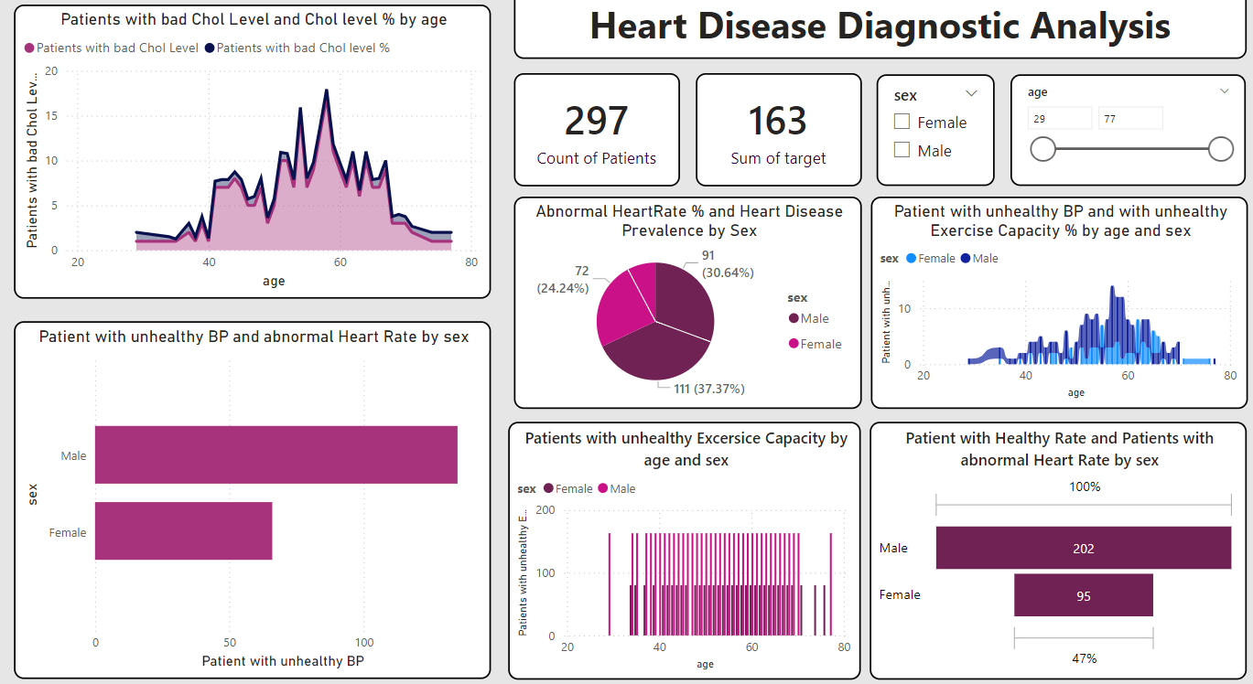
DATA VISUALIZATION

Slide 8
conclusion
Collecting accurate information is key to diagnosing and treating heart disease well. This includes taking a patient’s history, doing physical exams, and using tests like ECGs and blood tests. Advanced tools like imaging scans and wearables give extra details. With all this information, doctors can spot heart issues early, tailor treatments to each person, and improve care. Good data leads to better diagnoses, helps prevent serious problems, and makes sure patients have a better quality of life.

Slide 9
Thank You

